Slide 1
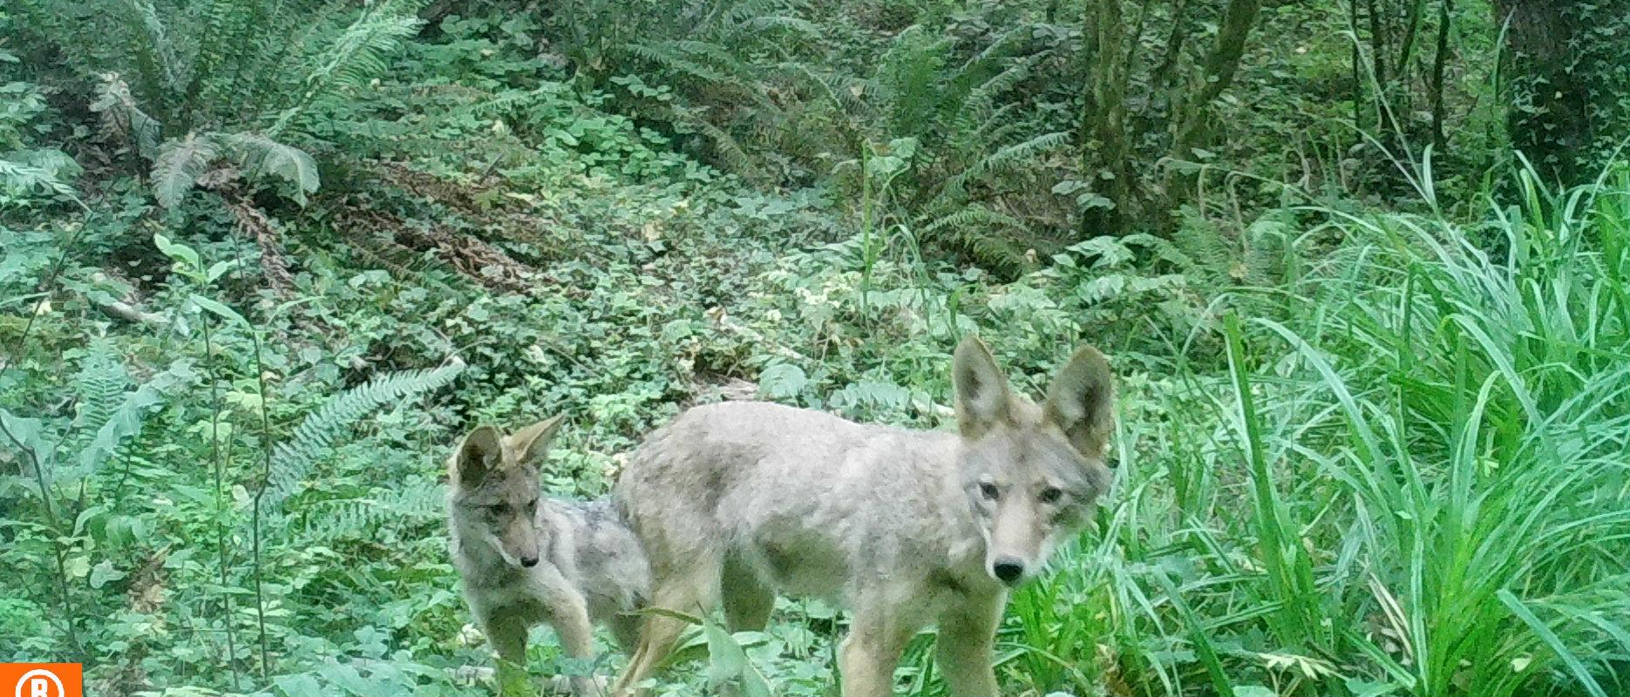
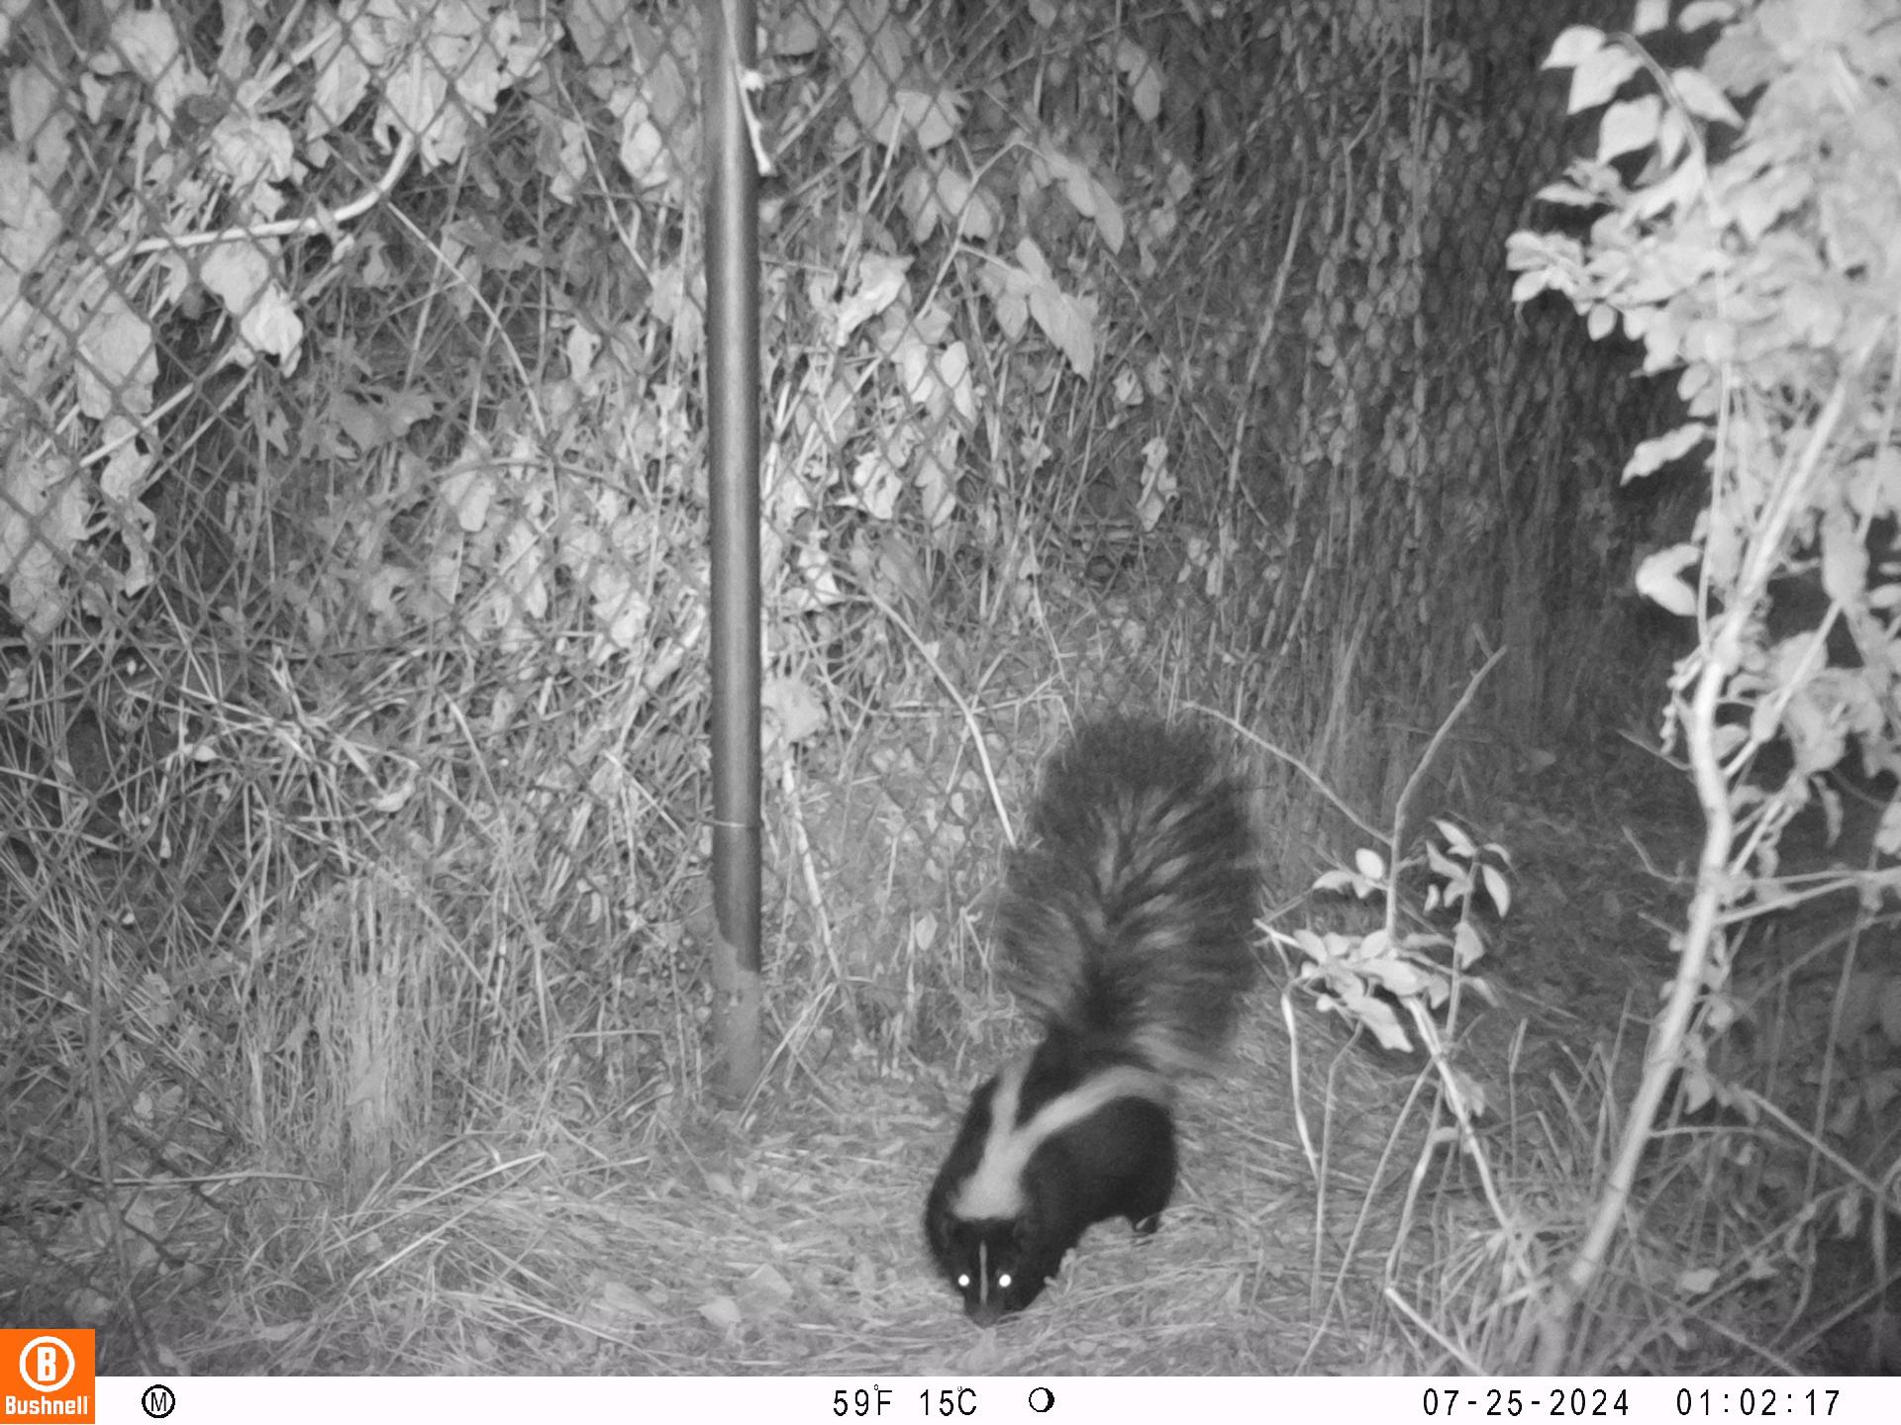



Urban Wildlife Information Network: Portland Oregon
Wildlife Monitoring Update

Slide 2

International collaborative research network coordinated by the Urban Wildlife Institute at Lincoln Park Zoo.
Uses standardized monitoring methods to create the world’s largest repository of urban wildlife data.
Connects scientists, practitioners, and volunteers across dozens of cities using consistent protocols for true cross-city comparisons.
Portland Chapter
Monitors wildlife across the metro area to track species diversity, seasonal activity, and habitat use.
Contributes data to the global UWIN database, helping reveal patterns of wildlife behavior and adaptation in cities worldwide.

Slide 3
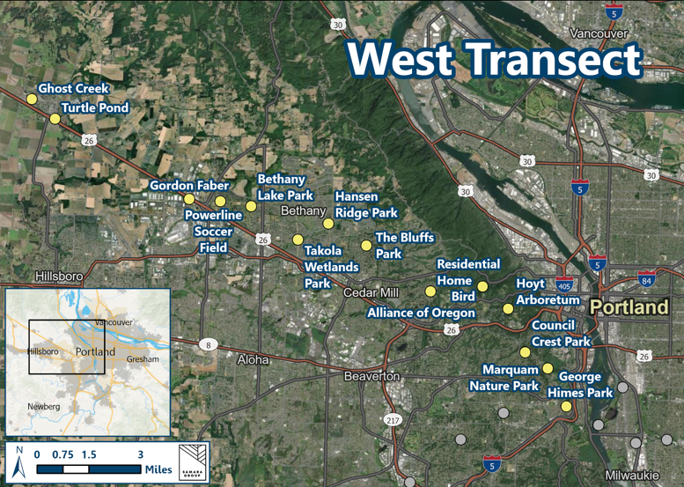
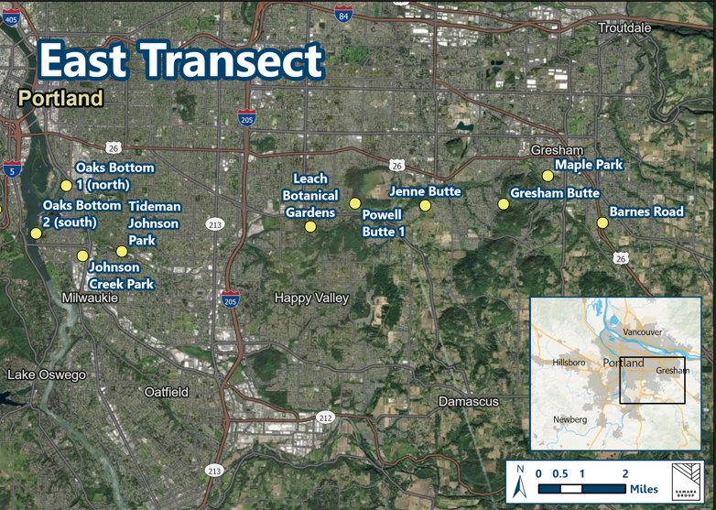
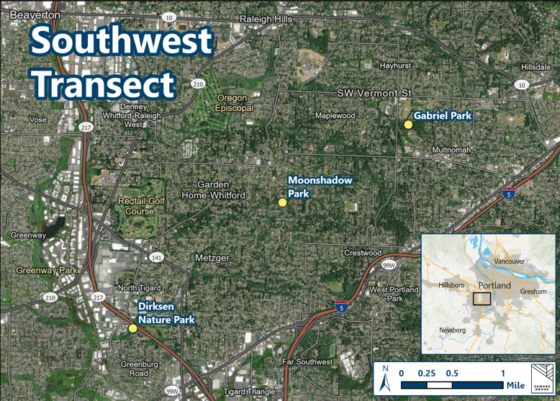
Portland Wildlife Monitoring Locations (27)
10 Locations
14 Locations
3 Locations

Slide 4
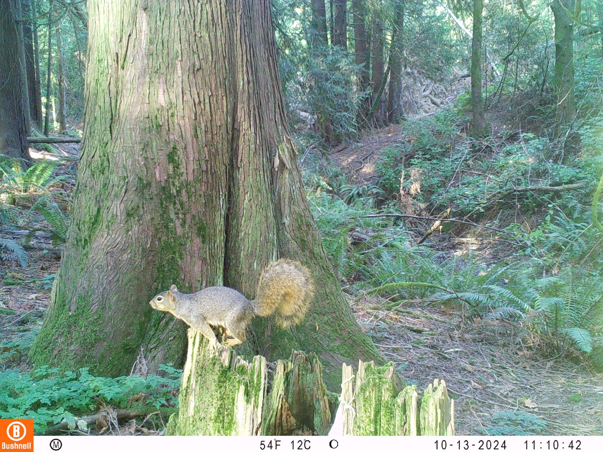
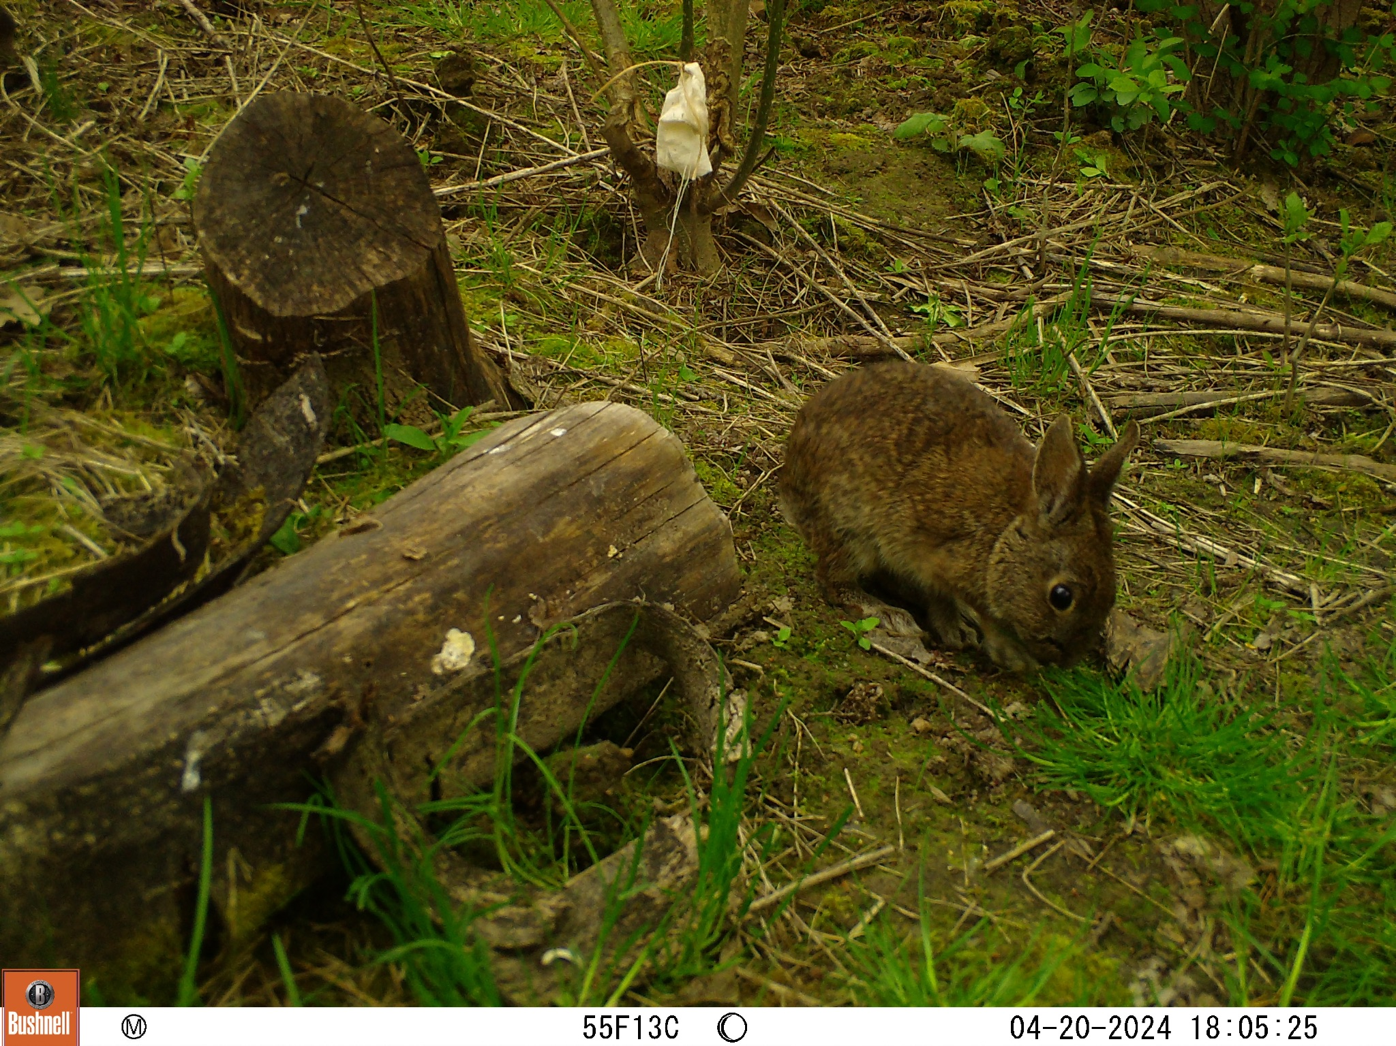
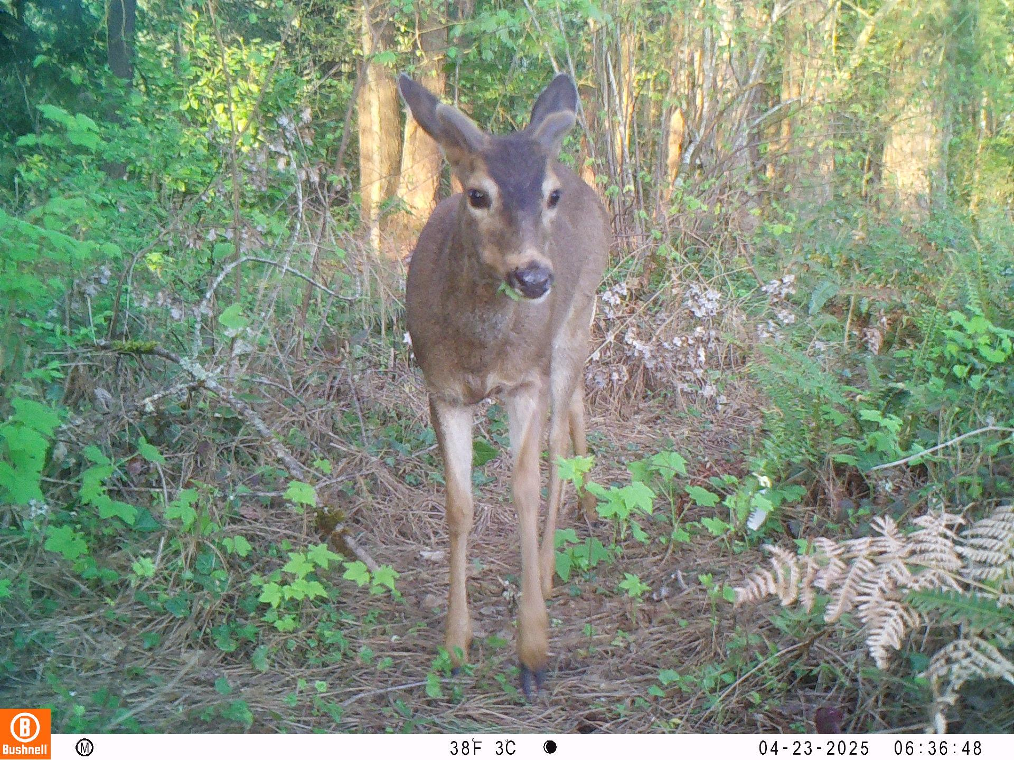
2024–2025 Volunteer Coordination
13 field volunteers monitoring 27 camera locations across the metro area.
Cameras deployed four times per year (Jan, Apr, Jul, Oct).
Volunteers complete the full monitoring cycle each season:
Set cameras at the start of the month
Mid-month check to ensure functionality
Retrieve cameras at month’s end
Volunteers upload wildlife photos, which are then processed into the UWIN database.

Slide 5
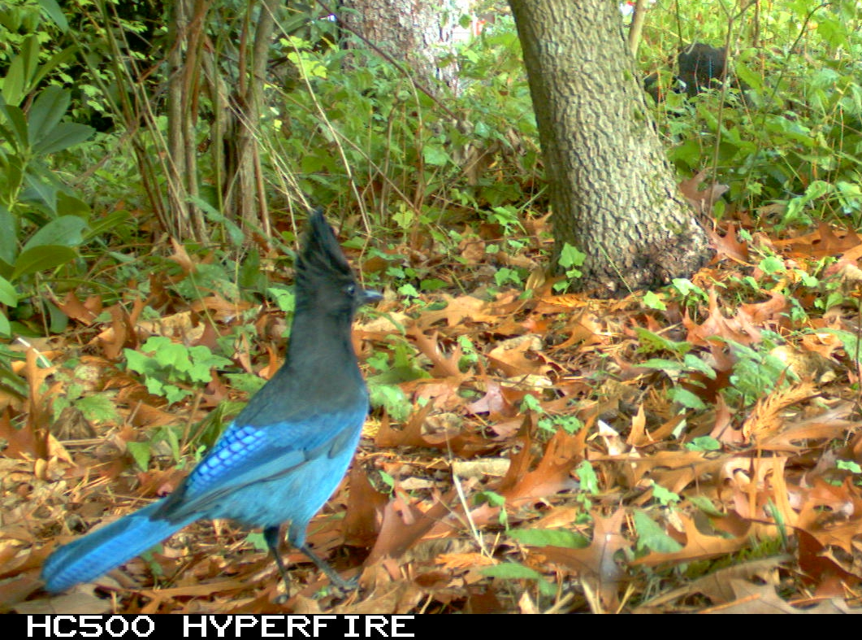
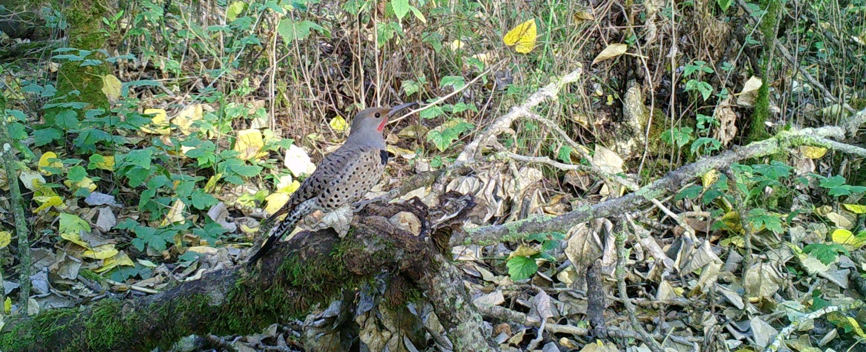
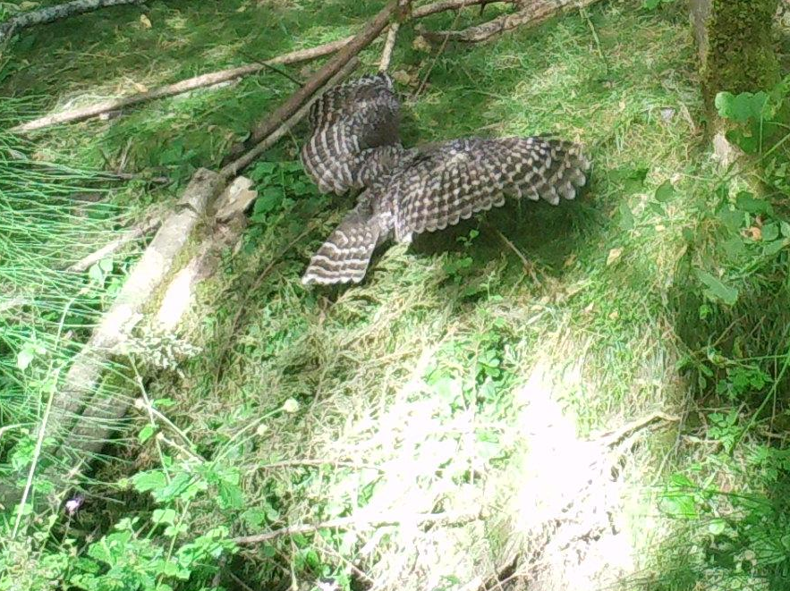
Photo Tagging & Data Cleanup
8 active photo-tagging volunteers supporting species identification.
Every photo goes through double identification (two independent reviewers).
Any conflicting IDs are sent to third-party validators for final review.
This workflow ensures high-quality, reliable data for the UWIN dataset.

Slide 6
Data Summary: Totals for 2024
7716 Records: Individual detections (photos tagged through UWIN portal)
24% Birds and 76% Mammals
62 “Species”: Excludes humans, domestic animals, unknowns, and invertebrates, but does include “cannot ID” categories that describe situations where the general animal type was identifiable but the specific species was unclear (for example: Squirrel,Cannot ID)
66% Birds and 34% Mammals
Majority of the detections are mammals
Majority of the species are birds

Slide 7
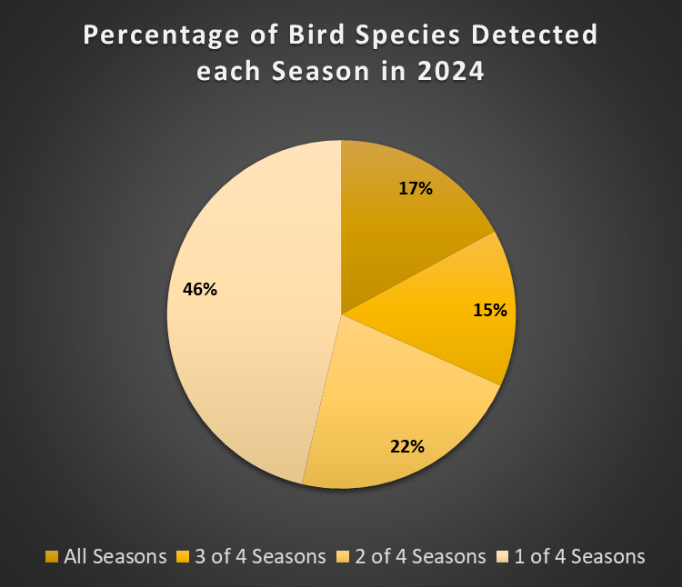
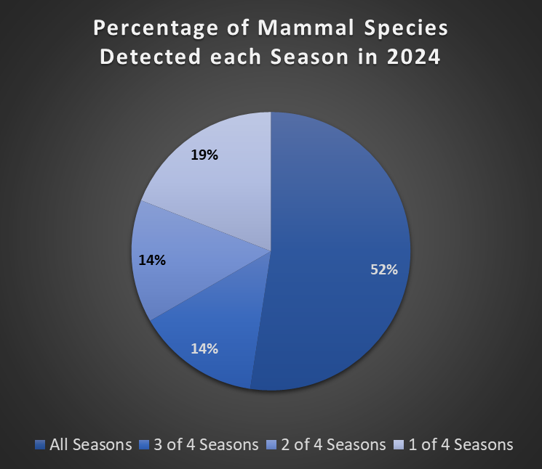
Data Summary: Seasonal Totals
Notes:
Most of our documented birds were only seen in one season, which makes sense when we think about migratory birds and that natural increase in diversity that would occur during those monitoring seasons. For mammals it was the opposite with most of the species detected across all seasons and fewer being documented less frequently.

Slide 8
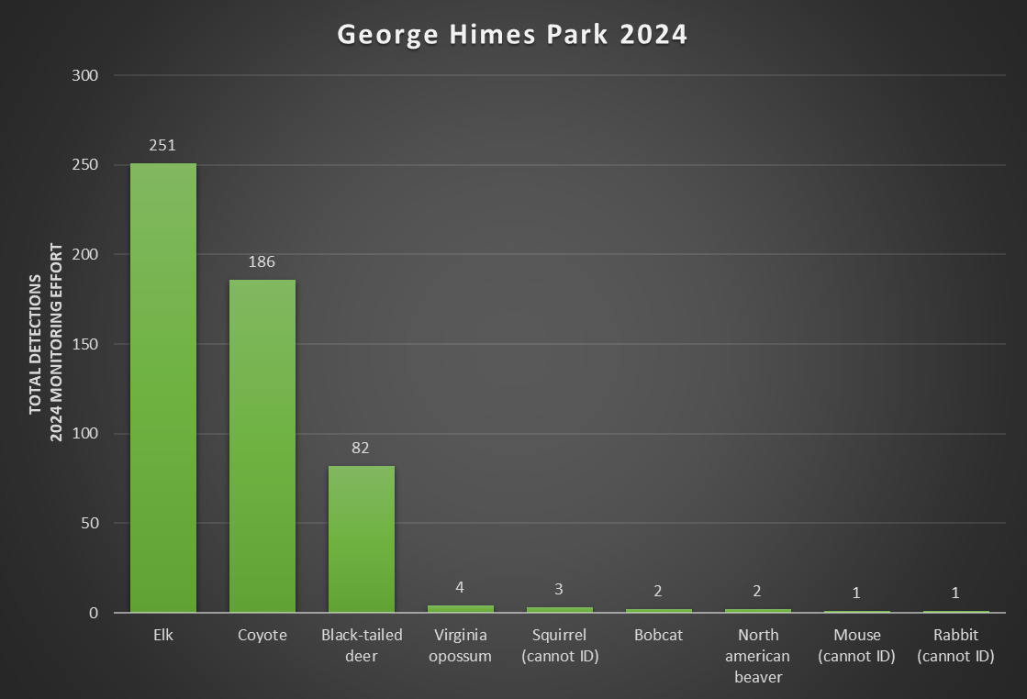
Data Summary: Exploring Specific Locations
George Himes Park Example:
532 records
9 species

Slide 9
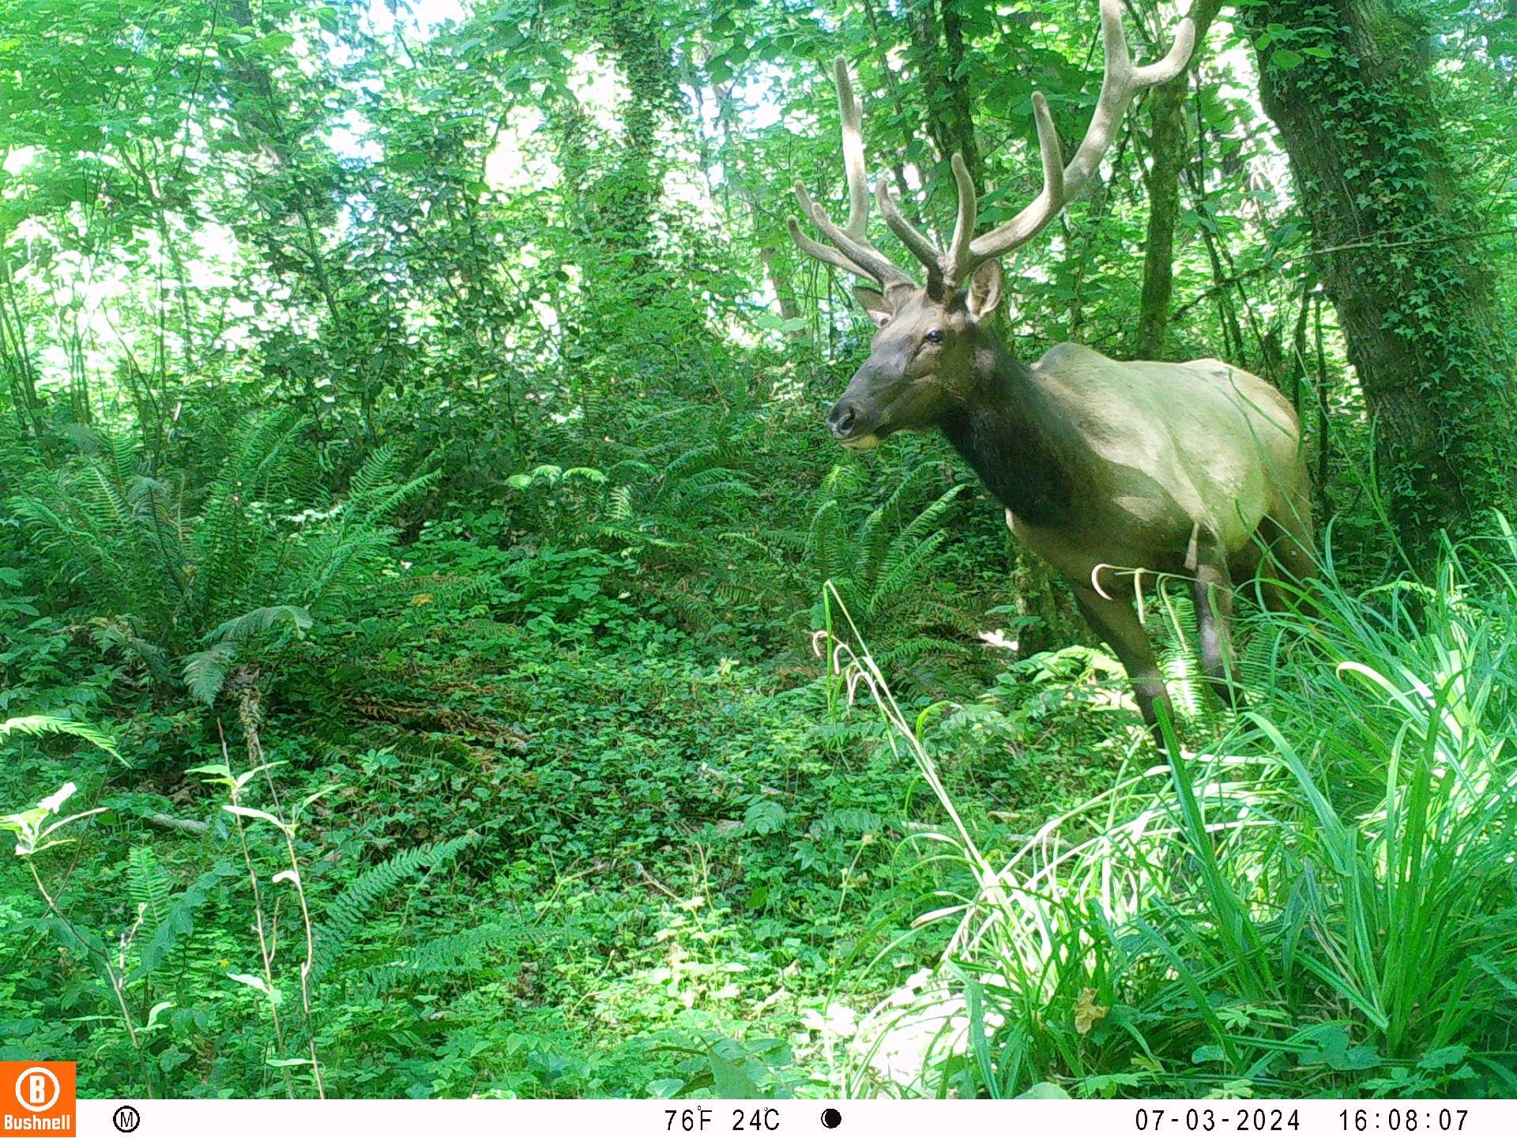

Slide 10
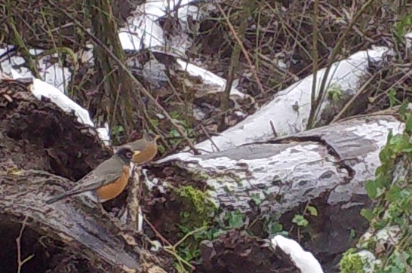
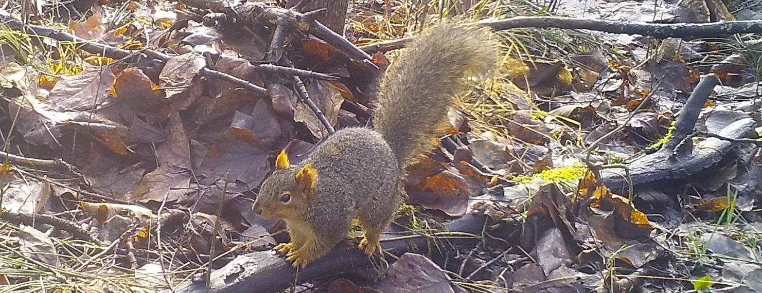
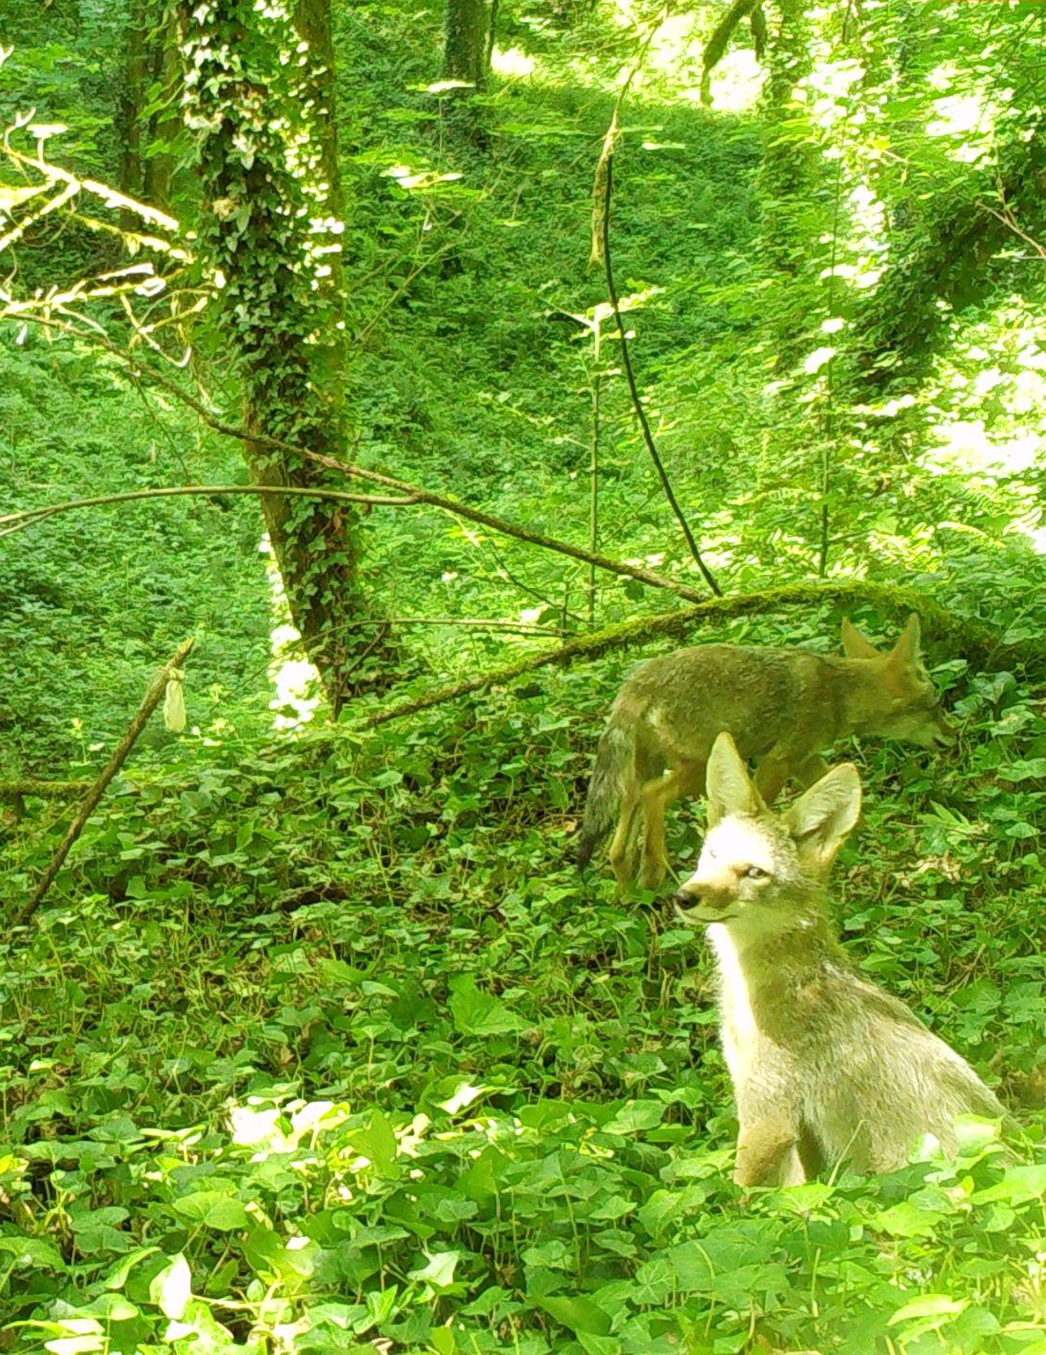
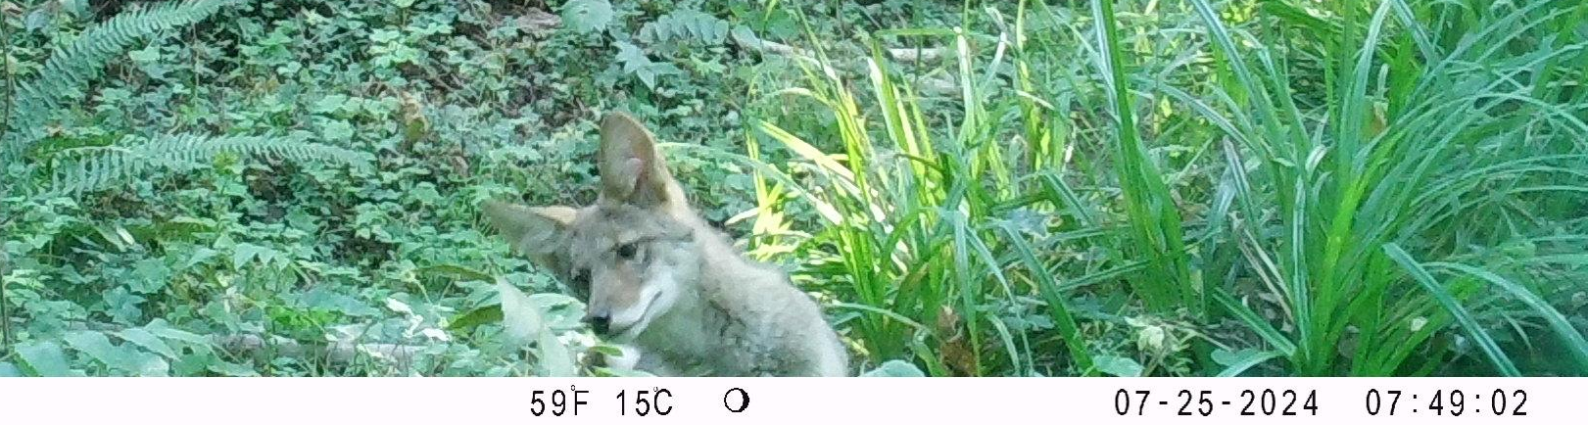
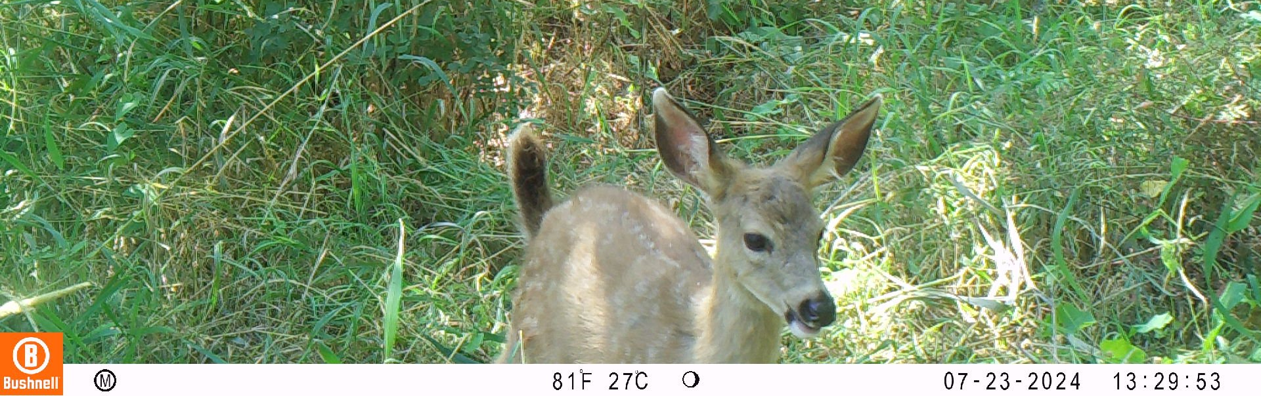
Photo Highlights

Slide 11
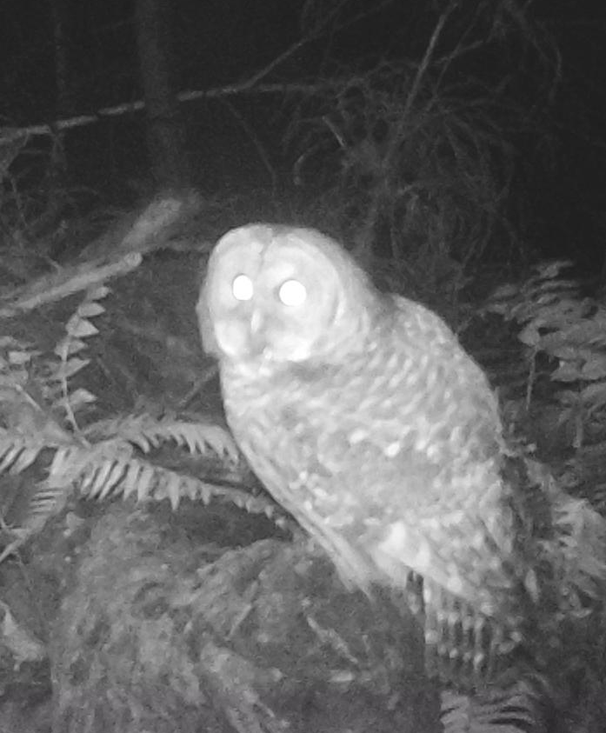
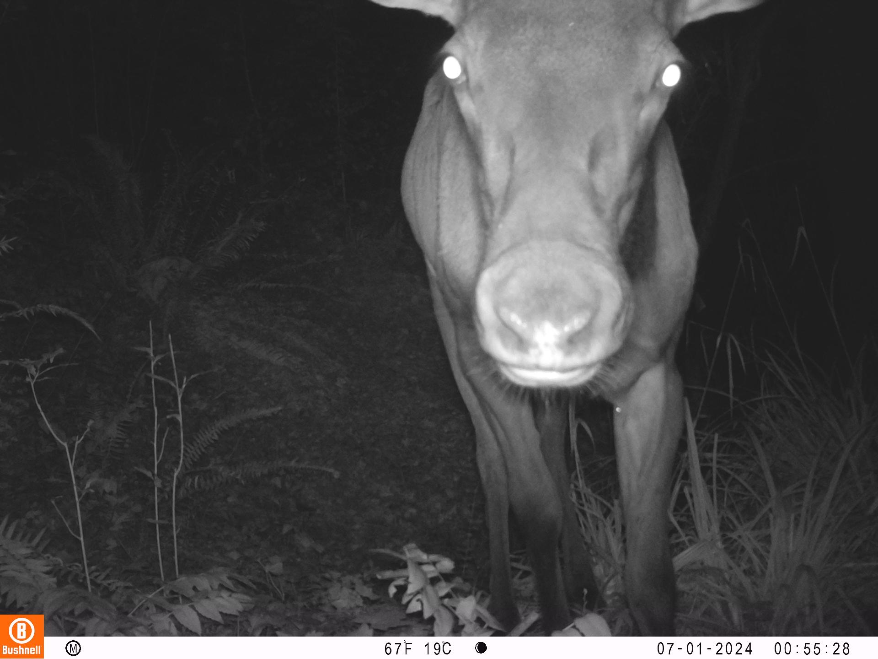
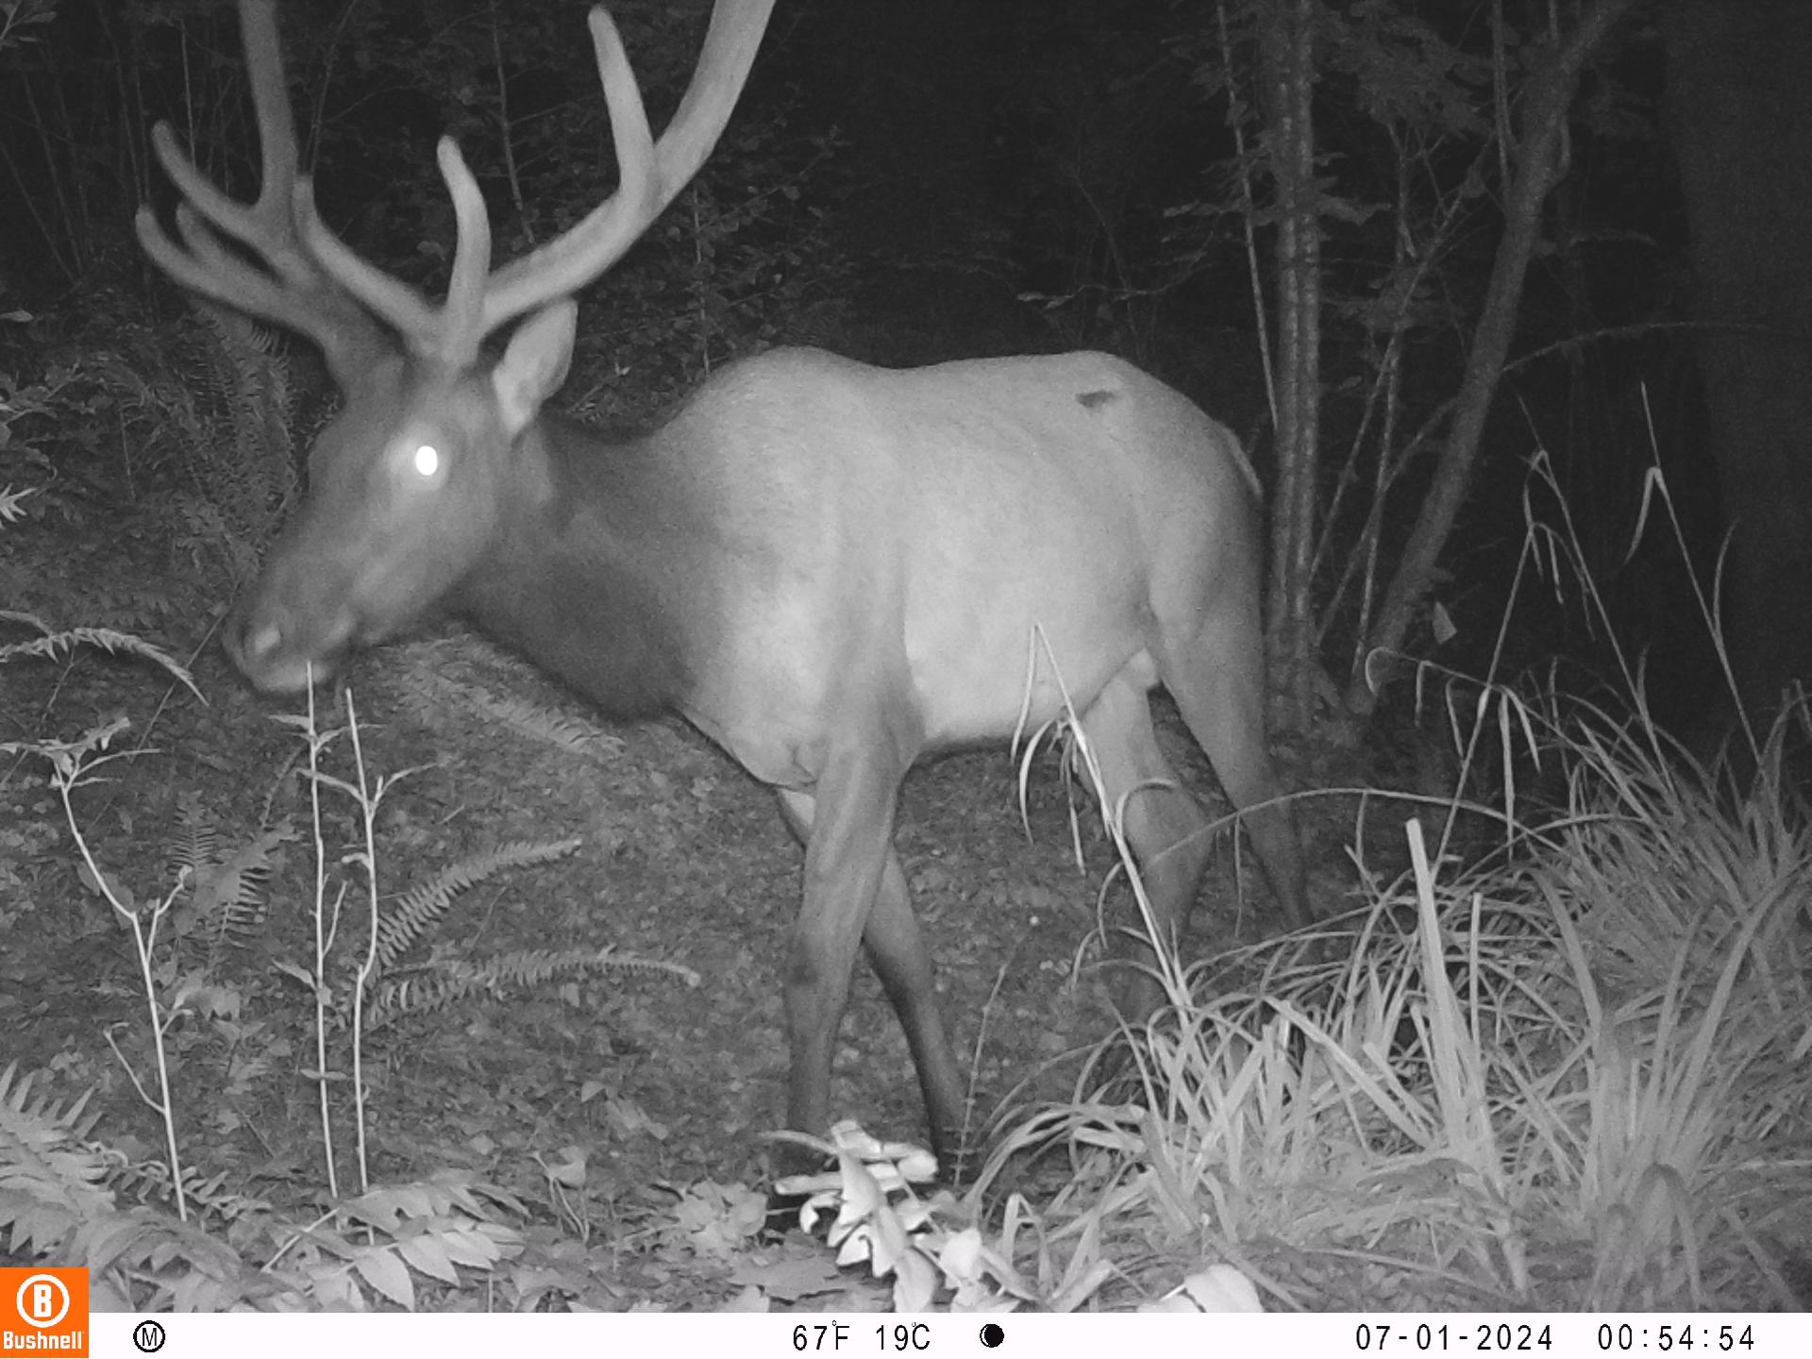
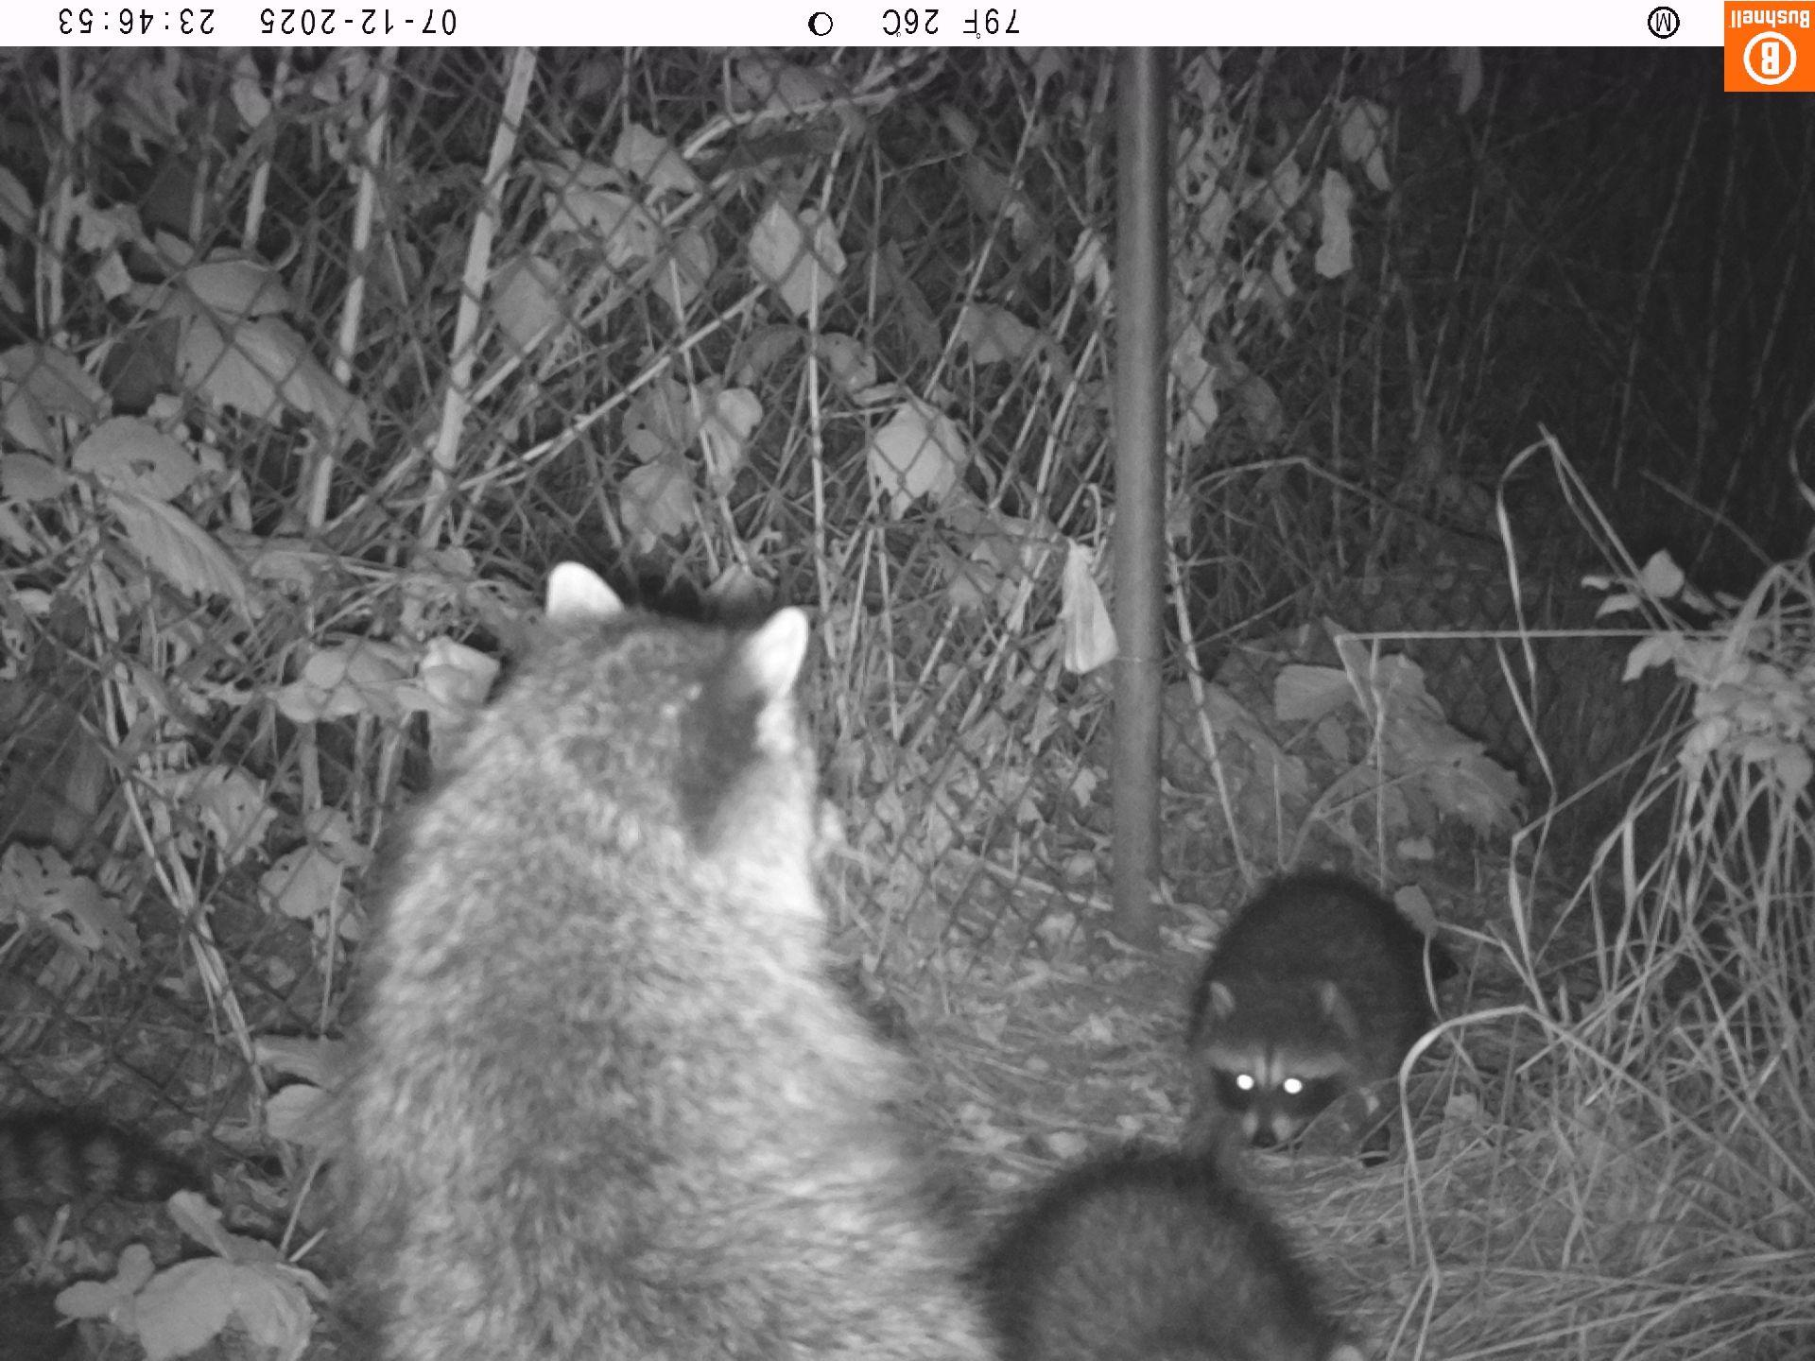
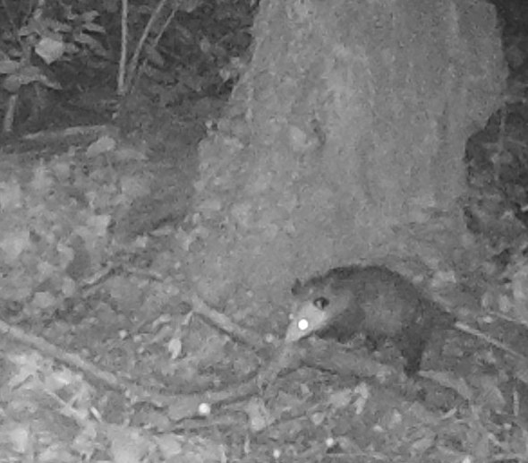
Photo Highlights

Slide 12
UWIN Organization
Currently a partnership between Oregon Wildlife Foundation, Bird Alliance of Oregon, and Samara Group
Determining how best to organize the project going forward
Working to integrate UWIN wildlife monitoring into public land management plans and large-landscape initiatives
Existing partner and potential partner survey
Identifying revenue opportunities to help ensure sustainability of this project

